Slide 1

IBM Data Science Capstone SpaceX Project
Sena KAYA
Nov 24, 2022

Slide 2

Outline
Executive Summary
Introduction
Methodology
Results
Conclusion
Appendix

Slide 3
Executive Summary
Summary of methodologies
Data collection via API and Web Scraping
Exploratory Data Analysis with SQL (Data Wrangling)
EDA with Data Visualization
Interactive Map with Folium
Predictive Analysis Using Machine Learning
Summary of all results
Exploratory Data Analysis Result
Interactive Analytics in Screenshots
Predictive Analytics Result

Slide 4
Introduction
Project background and context
Space X advertises Falcon 9 rocket launches on its website with a cost of 62 million dollars; other providers cost upward of 165 million dollars each, much of the savings is because Space X can reuse the first stage. Therefore, if we can determine if the first stage will land, we can determine the cost of a launch. This information can be used if an alternate company wants to bid against space X for a rocket launch. This goal of the project is to create a machine learning pipeline to predict if the first stage will land successfully.
Problems you want to find answers:
Which attributes determine if the rocket will land successfully?
What are the effects of each association of rocket variables on the success or failure of the landing?
What are the conditions that will allow SpaceX to achieve the best landing success rate?

Slide 5
Methodology

Slide 6

Methodology
Data collection methodology:
Describe how data was collected
Perform data wrangling
Describe how data was processed
Perform exploratory data analysis (EDA) using visualization and SQL
Perform interactive visual analytics using Folium and Plotly Dash
Perform predictive analysis using classification models
How to build, tune, evaluate classification models

Slide 7
Data Collection
The data was collected using various methods;
SpaceX launch data is taken from the SpaceX REST API.
This API gives data about launches, additional information about the rocket used, payload delivered, launch specifications, landing specifications, and landing outcome.
Another data source is Wikipedia. Falcon 9 Launch data is web scraping using BeautifulSoup.
The goal is to use the data to predict whether SpaceX will land successfully or not.
We then cleaned the data, checked for missing values and fill in missing values where necessary.

Slide 8
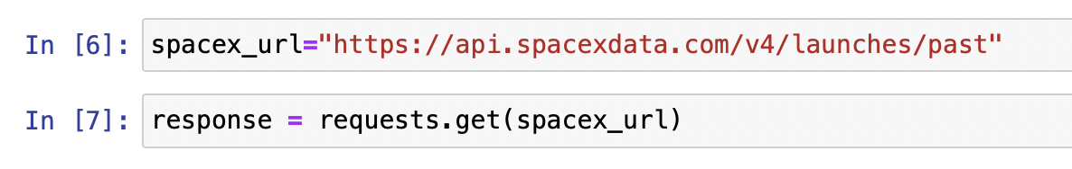
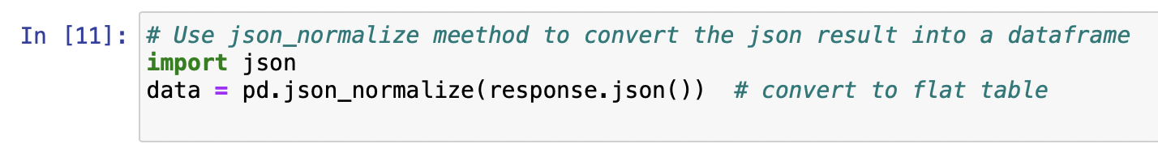
Data Collection – SpaceX API
1- Response from API
2- Convert response to .json file
3- Data cleaning and filling missing data
4- Create a data frame from dictionary
1
2
Link

Slide 9
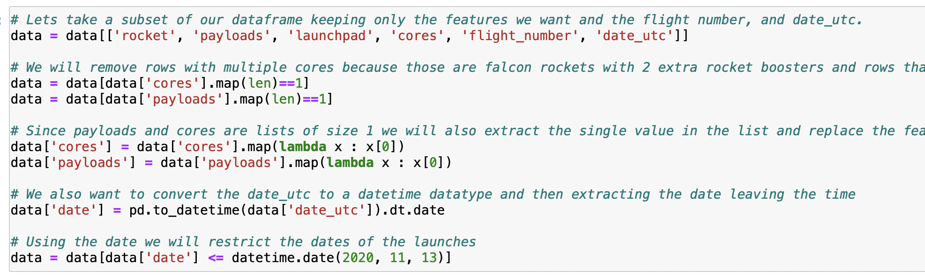
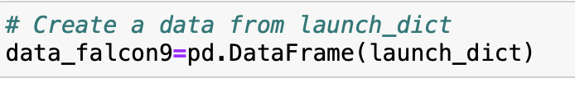
Data Collection – SpaceX API
1- Response from API
2- Convert response to .json file
3- Data cleaning and filling missing data
4- Create a data frame from dictionary
3
4

Slide 10
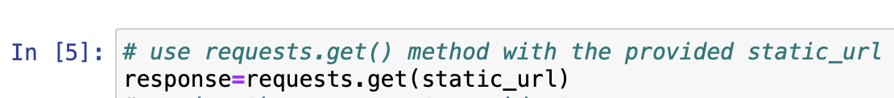
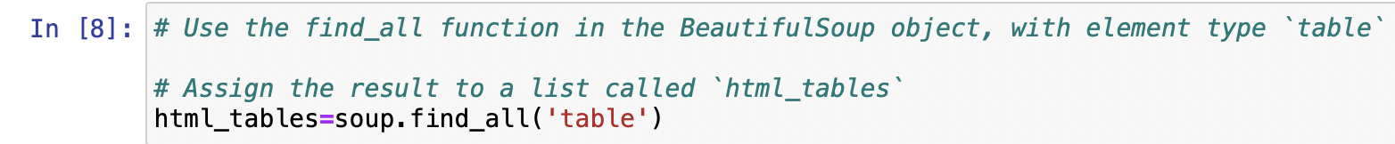
Data Collection - Scraping
1- Request Wikipedia html
2- Creating BeautifulSoup Object
3- Find out table
4- Create a dictionary
5- Create a data frame from dictionary
1
2
3
Link

Slide 11
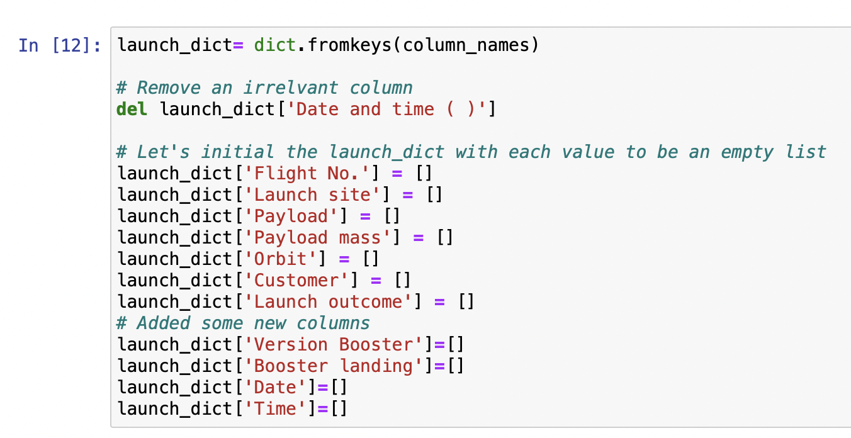
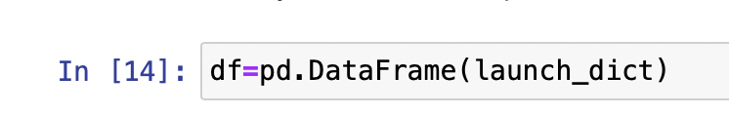
Data Collection - Scraping
4
5

Slide 12
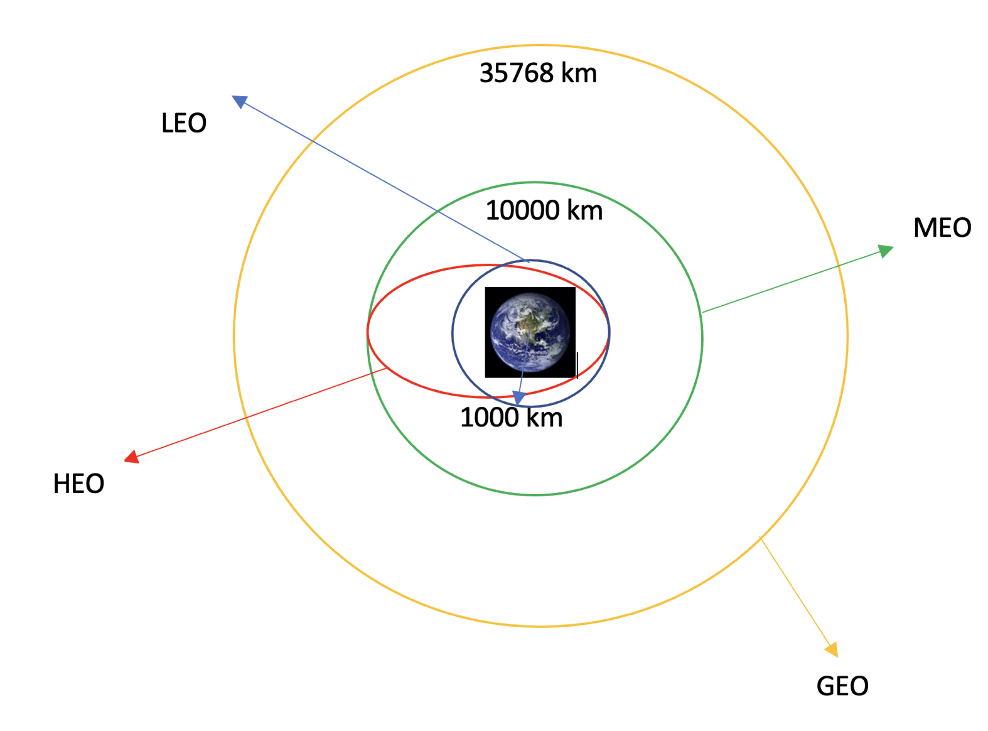
Data Wrangling
There are several cases where the booster did not land successfully. In the data set, False Ocean, False RTLS, False ASDS means the mission was not completed. On the other hand, True Ocean, True RTLS, True ASDS means the mission was completed.
Creating a training label with landing outcomes where successful = 1 and failure = 0.
Common orbit types SpaceX uses
Link

Slide 13
Data Wrangling - Process
1 - Perform exploratory data analysis EDA on dataset
2 - Calculate the number of launches at each site
3 - Calculate the number and occurrence of each orbit
4 – Calculate the number and occurrence of mission outcome per orbit type
7 – Work out success rate for every landing in dataset
6 – Create a landing outcome label from outcome column
5 – Export dataset as .CSV
13

Slide 14
EDA with Data Visualization
Scatter Graphs *
Flight Number vs. Payload Mass
Flight Number vs. Launch Site
Payload vs. Launch Site
Orbit vs. Flight Number
Payload vs. Orbit Type
Orbit vs. Payload Mass
* Relationship between variables - correlation
Bar Graph *
Success rate vs. Orbit
* Relationship between numeric and categorical variables
Line Graph *
Success rate vs. Year
* Shows data variables and trends that helps to predict about result not yet recorded
Link
14
14

Slide 15
EDA with SQL
EDA is used to get insight from data by SQL queries. Some of answers are getting by SQL queries. For example:
The names of the unique launch sites in the space mission,
5 records where launch sites begin with the string 'CCA’,
The total payload mass carried by boosters launched by NASA (CRS),
Average payload mass carried by booster version F9 v1.1,
List the date when the first successful landing outcome in ground pad was achieved,
List the names of the boosters which have success in drone ship and have payload mass greater than 4000 but less than 6000,
List the total number of successful and failure mission outcomes,
List the names of the booster_versions which have carried the maximum payload mass…
15
15
15

Slide 16
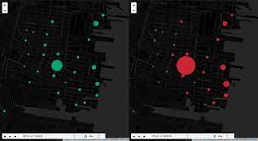
Build an Interactive Map with Folium
Launch Data is visualized on an interactive map.
After getting the Latitude and Longitude coordinates at each launch
site, they are indicated by a circle marker and labeled with the launch
site name.
Folium.Circle , folium.map.Marker , folium.features.DevIcon
Assigned the dataframe launch_outcomes to classes 0 and 1 on the map
in a MarkerCluster(). 1 is implied success and 0 is implied failure.
Calculated the distance between a launch site to a specified place such as highway, coastlines, railways etc.
16
16
16

Slide 17

Build a Dashboard with Plotly Dash
An interactive dashboard built with Plotly Dash.
Dropdown allows users to choose the specific launch
site or all launch sites.
Pie charts are showing the total launches according
to each different sites.
Range slider allows users to select a payload mass in
a fixed range.
Plotted scatter graph is showing the relationship with
Outcome and Payload Mass (kg) for different booster
version.
Link
17
17
17
17

Slide 18

Predictive Analysis (Classification)
Data Preparation
Load dataset into pandas
Transform data
Split dataset into training and test set
Model Preparation
Decide the type of machine learning algorithm
Set parameters and the algorithm to GridSearchcv
Fit the dataset into the GridSearchCV objects and train it.
Evaluating Model
Check accuracy for each model
Get tuned hyperparameters for each type of algorithm
Plot confusion matrix
Approaching to the best model
Feature Engineering
Algorithm Tuning
*The model with the best accuracy score is the best model!
18
18
18
18
18

Slide 19

Results
Exploratory data analysis results
Interactive analytics demo in screenshots
Predictive analysis results
19
19
19
19
19

Slide 20
Insights drawn from EDA
20

Slide 21

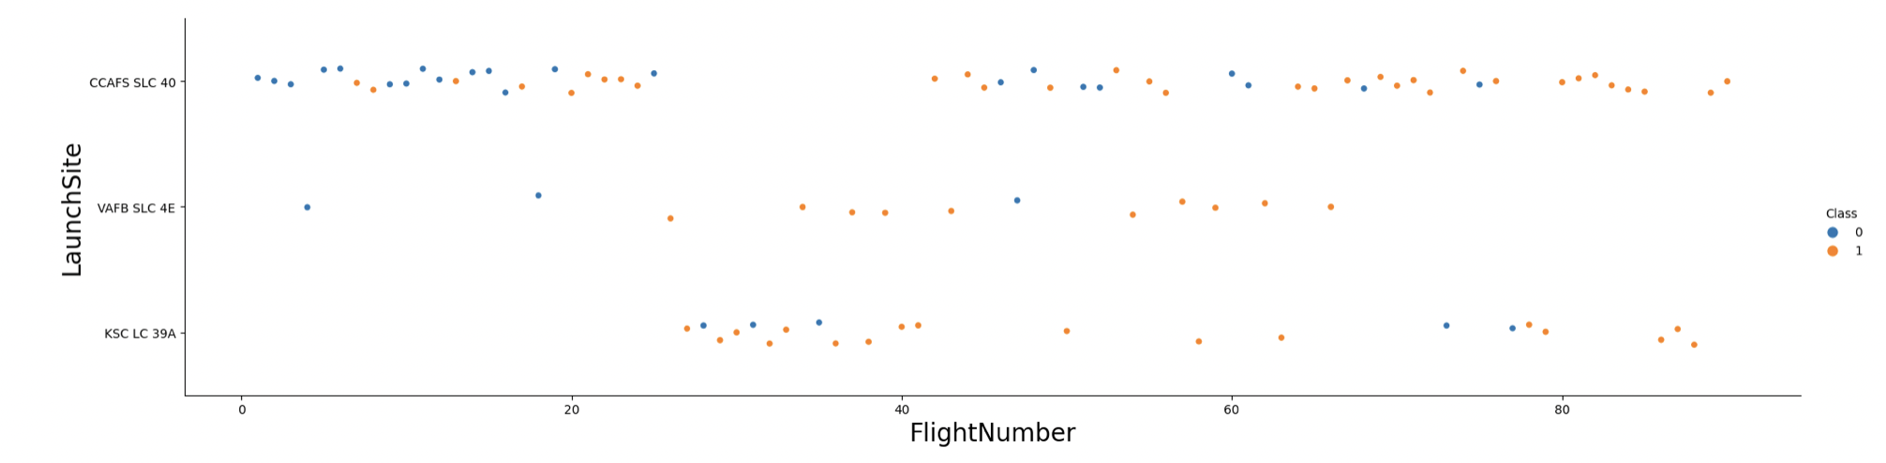
Flight Number vs. Launch Site
The success rate is increasing.
Link
21
21
21
21
21

Slide 22
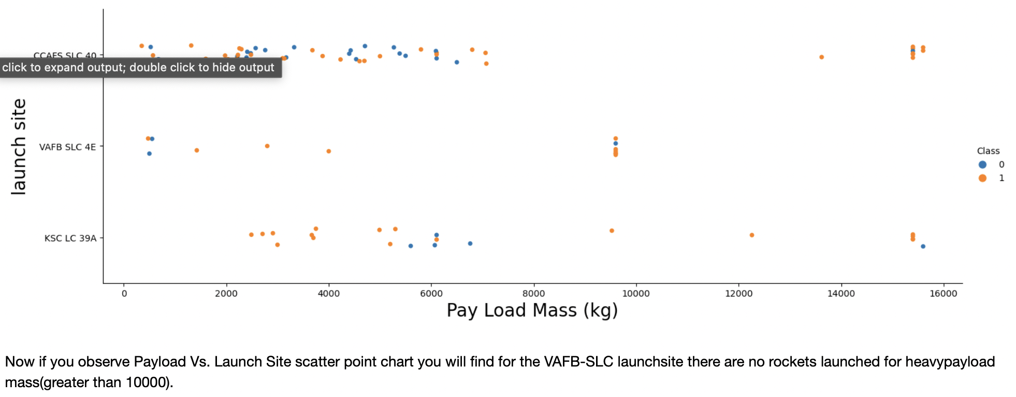
Payload vs. Launch Site
The greater payload mass for launch site, the higher the success rate. On the other hand, too much heavy payload can cause the failure.
22
22
22
22

Slide 23
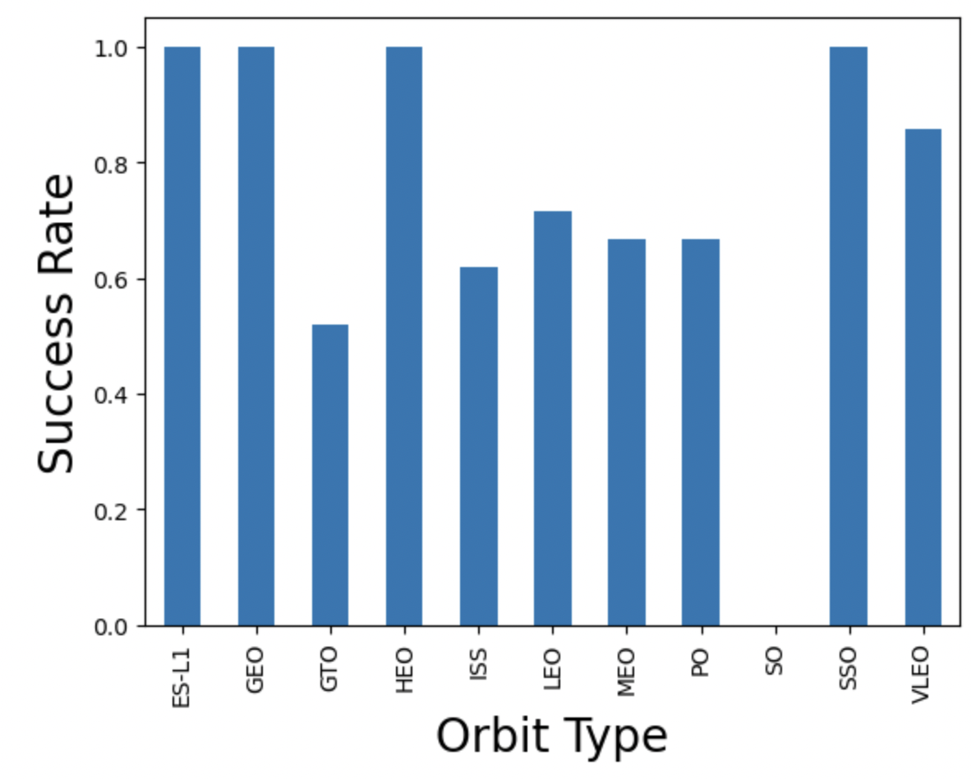
Success Rate vs. Orbit Type
This plot shows the success rates for each orbit type.
23
23
23
23
23

Slide 24
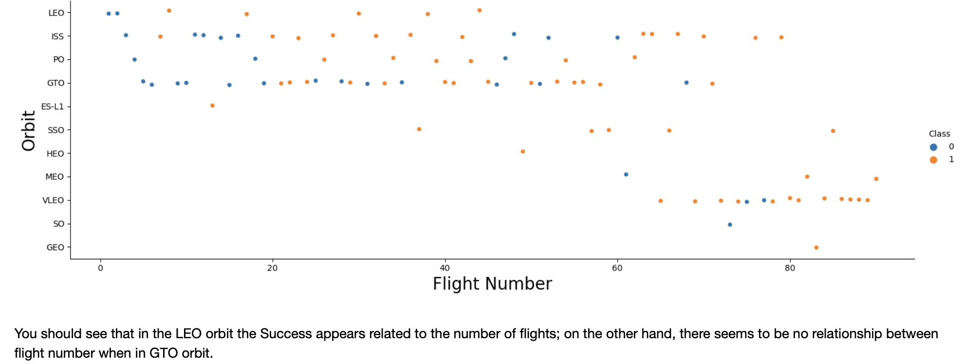
Flight Number vs. Orbit Type
This plot shows the flight number vs orbit type. For LEO orbit type, the success is increasing when the flight number is increasing. On the other hand, there is no relationship between flight number and orbit for GTO orbit.
24
24
24
24

Slide 25
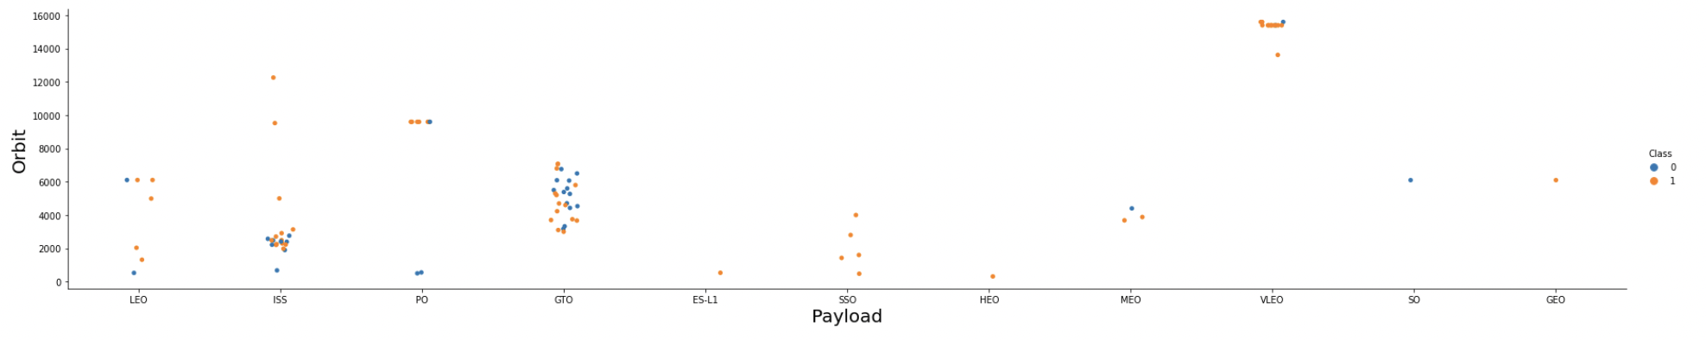
Payload vs. Orbit Type
This plot shows payload vs orbit type. With heavy payloads the successful landing or positive landing rate are more for Polar, LEO and ISS.
25
25
25
25
25

Slide 26
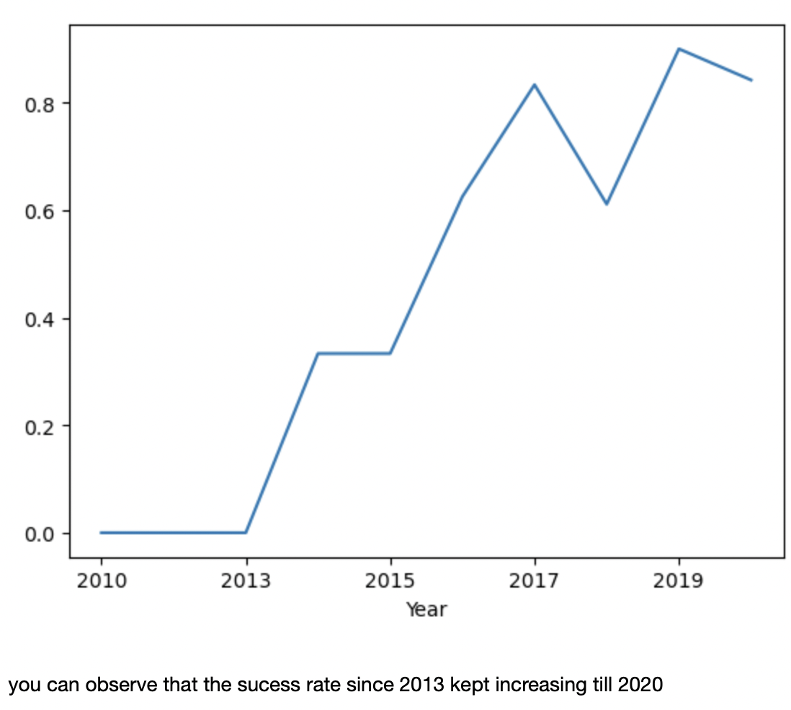
Launch Success Yearly Trend
The plot shows that the success rate in increasing from 2013 to 2020.
26
26
26
26
26

Slide 27
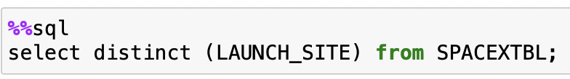
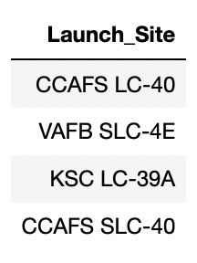
All Launch Site Names
SQL Query:
RESULTS
Explanation
Distinct comment is used to remove duplicate Launch_Site

Slide 28
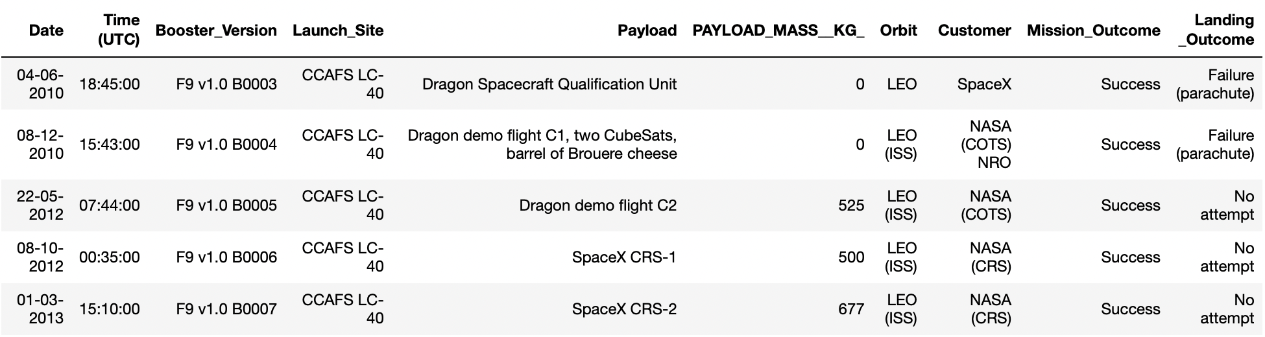
Launch Site Names Begin with 'CCA'
SQL Query:
Explanation
Where clause is used to filter
Limit ‘n’ is used to filter n number results
RESULTS
28
28
28

Slide 29
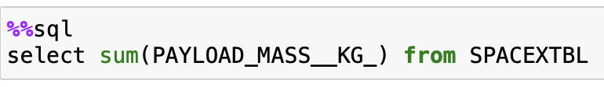
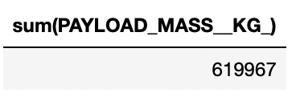
Total Payload Mass
SQL Query:
RESULTS
Explanation
Sum is used for the total payload mass
29

Slide 30
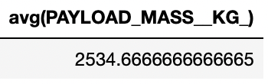
Average Payload Mass by F9 v1.1
SQL Query:
RESULTS
Explanation
Avg is used for the average payload mass
30

Slide 31
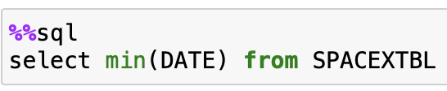
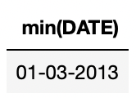
First Successful Ground Landing Date
SQL Query:
Explanation
Min (DATE) is used for the first successful landing outcome
RESULTS
31
31
31
31

Slide 32
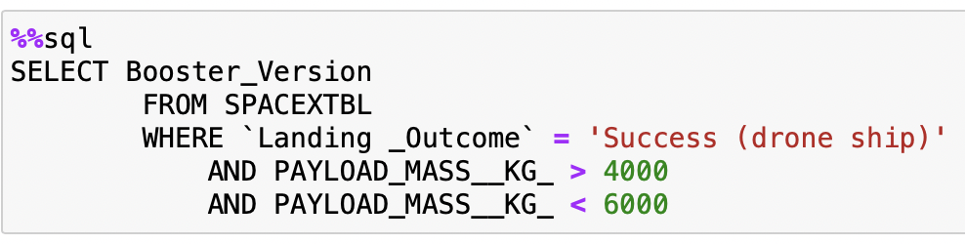
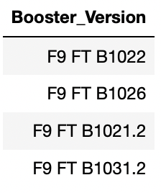
Successful Drone Ship Landing with Payload between 4000 and 6000
SQL Query:
RESULTS
Explanation
Where clause is used to filter payload mass greater than 4000 but less than 6000
32
32
32

Slide 33
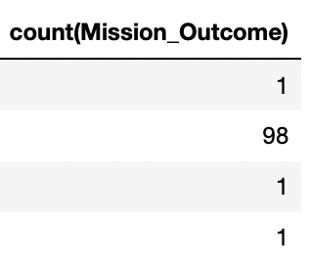
Total Number of Successful and Failure Mission Outcomes
SQL Query:
RESULTS
Explanation
Count clause is used for the total number of successful and failure mission outcomes
33

Slide 34
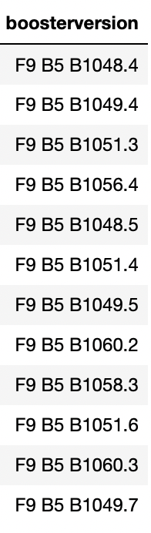
Boosters Carried Maximum Payload
SQL Query:
RESULTS
Explanation
Subquery is used to find the solution and max is used to find maximum payload mass
34

Slide 35
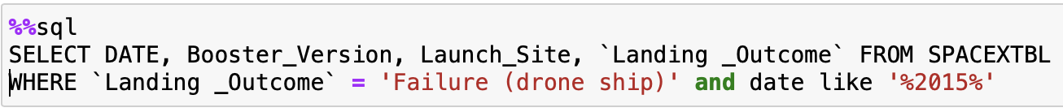
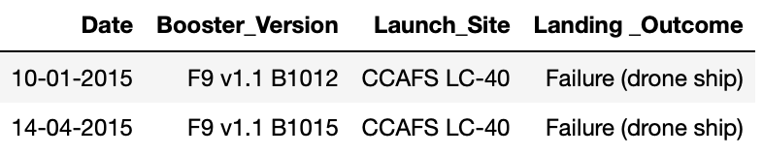
2015 Launch Records
SQL Query:
RESULTS
Explanation
Where clause is used to filter for failure and like is used to filter according to word in parentheses
35

Slide 36
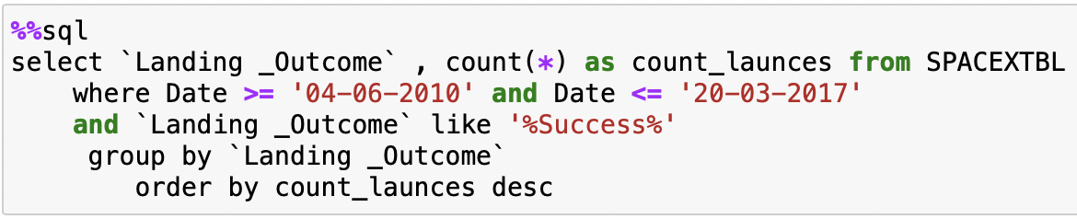
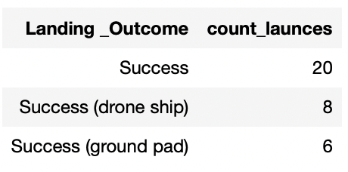
Rank Landing Outcomes Between 2010-06-04 and 2017-03-20
SQL Query:
RESULTS
Explanation
Where clause is used to filter for failure,
like is used to filter according to word in parentheses,
Group by is used to make groups according to Landing Outcome,
Order by is used to make a order the results.
36
36
36
36
36

Slide 37
Launch Sites
Proximities Analysis
37
37

Slide 38
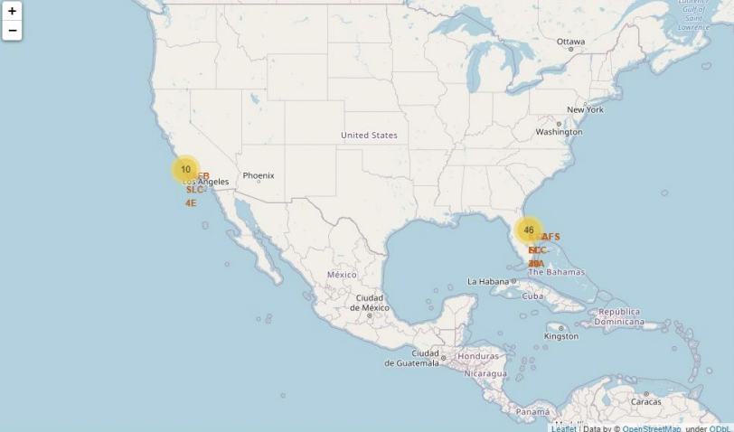
Folium Map- Global map markers
SpaceX launch sites are in the United States.
Link

Slide 39
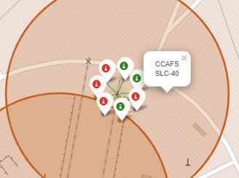
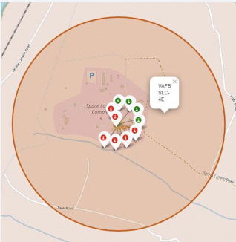
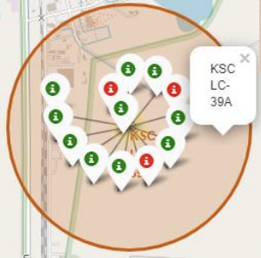
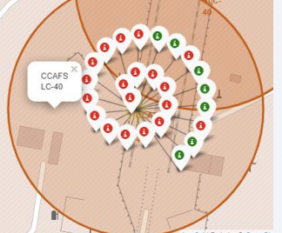
Folium Map- Color labeled markers
Green markers imply the successful launches and red markers imply the failure launches.
39

Slide 40
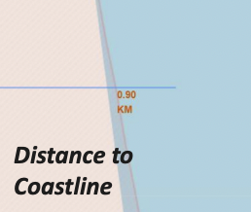
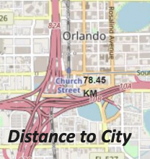
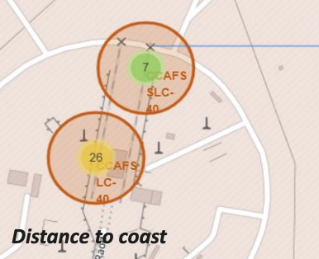
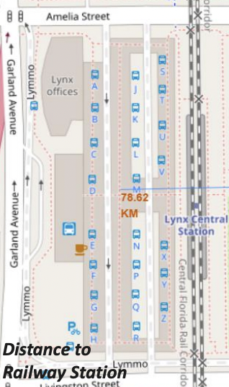
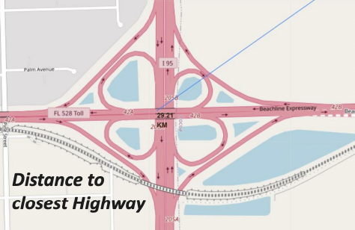
Folium Map- Distances between specific points
Are launch sites in close proximity to railways? No
Are launch sites in close proximity to highways? No
Are launch sites in close proximity to coastline? Yes
Do launch sites keep certain distance away from cities? Yes
40
40

Slide 41
Build a Dashboard with Plotly Dash
41
41
41

Slide 42
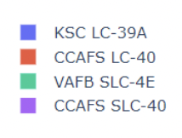
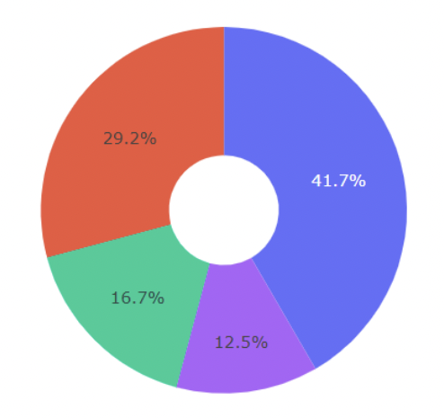
Dashboard- Pie Chart shows the success by launch site
KSC LC-39A is the most successful launch

Slide 43

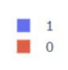
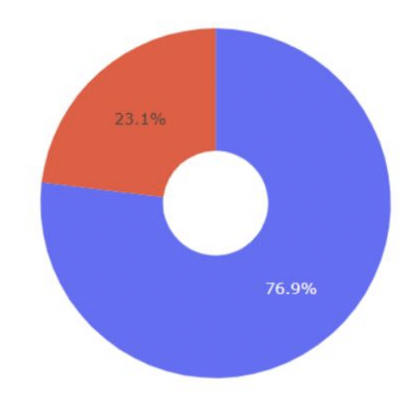
Dashboard- Pie Chart shows the highest launch success ratio
KSC LC-39A has achieved 76.9% success rate and 23.1% failure rate.

Slide 44
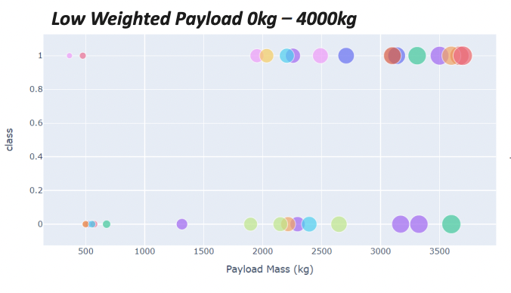
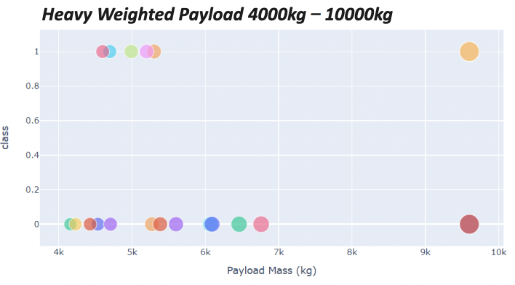
Dashboard- Pie Chart shows the highest launch success ratio
Payload mass vs outcome for all launch sites according to different selected payload mass

Slide 45
Predictive Analysis Classification
45
45
45
45

Slide 46
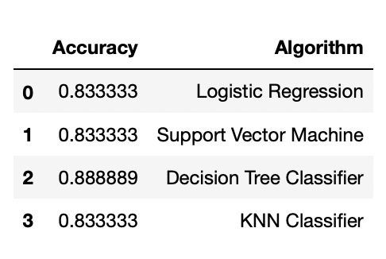
Classification Accuracy
Four different classification algorithms are applied to dataset. According to the results, decision tree classifier slightly outperforms the other algorithms with a better accuracy.
The decision tree algorithm’s best parameters:
46
46
46
46
46

Slide 47
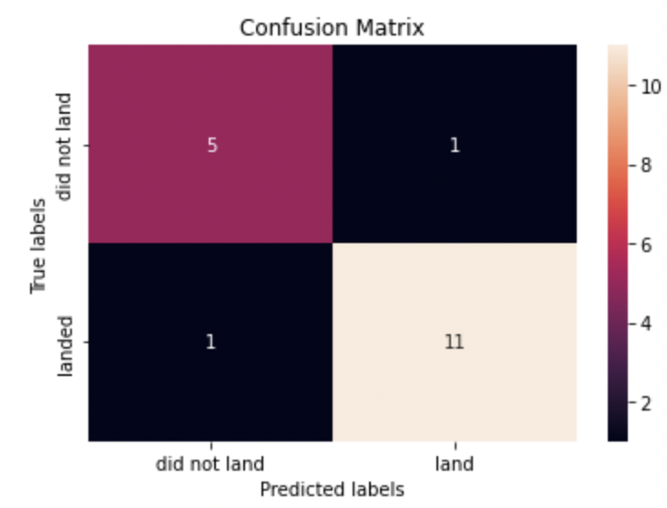

Confusion Matrix
The decision tree’s confusion matrix :
Tree can distinguish between the different classes. It misclassified only two observations :
1 FALSE NEGATIVE, 1 FALSE POSITIVE.
Other three algorithms’ confusion matrix :
They misclassified three observations :
3 FALSE POSITIVE. The main problem with these algorithms is that they are inclined to classify observations as positive.
47
47
47
47
47

Slide 48

Conclusions
According to the datasets, we can conclude that:
The larger the flight amount at a launch site, the greater the success rate at a launch site.
The number of successful launches has been increasing over the years.
A heavier payload mass may result in a reduced number of successful launches.
The orbits with the best success rates are GEO, HEO, SSO, ES-L1.
KSC LC-39A had the most successful launches of any sites.
Decision tree classifier slightly outperforms the other algorithms with a better accuracy. For example: the accuracy of decision tree algorithm is .88, but the accuracy of other three algorithm are identical (.83).
48
48
48
48
48

Slide 49

Appendix
All relevant assets like Python, SQL queries, charts,
and data sets that you may have created during this
project are available on my Github account.
Link
49
49
49
49
49

Slide 50
Thank You!
50

